Slide 1
Filtering
Most slides from Steve Seitz

Slide 2
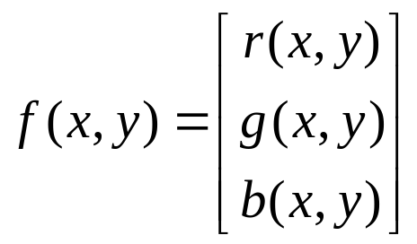
What is an image?
We can think of an image as a function, f, from R² to R:
  f( x, y ) gives the intensity at position ( x, y )
  Realistically, we expect the image only to be defined over a rectangle, with a finite range:
    f: [a,b]x[c,d] → [0,1]
A color image is just three functions pasted together. We can write this as a “vector-valued” function:
Notes:
As opposed to [0..255]

Slide 3
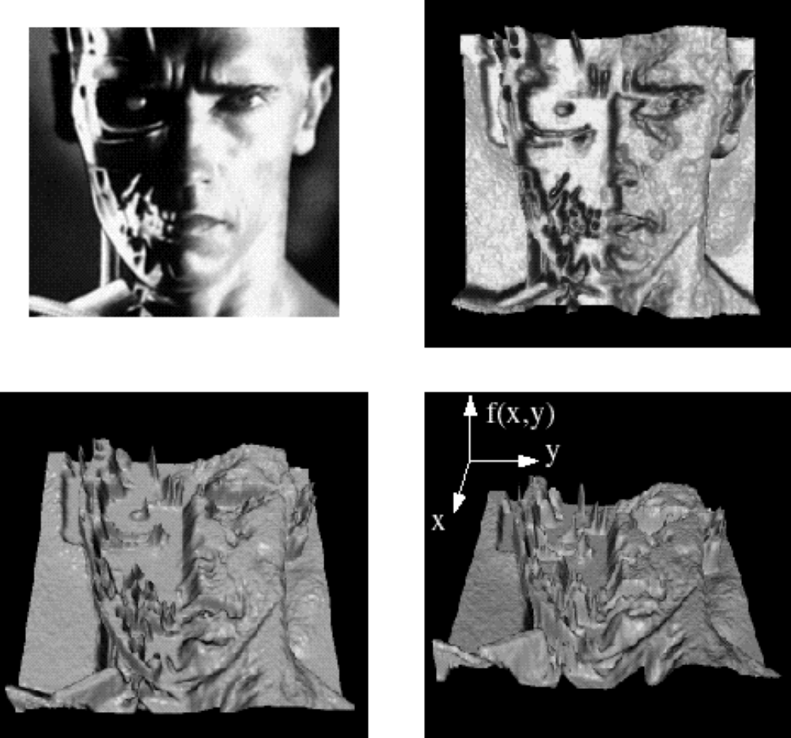
Images as functions
Notes:
Render with scanalyze????

Slide 4

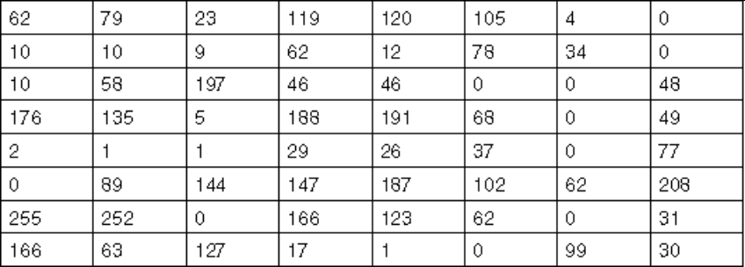
What is a digital image?
In computer vision we usually operate on digital (discrete) images:
  Sample the 2D space on a regular grid
  Quantize each sample (round to nearest integer)
If our samples are Δ apart, we can write this as:
f[i ,j] = Quantize{ f(i Δ, j Δ) }
The image can now be represented as a matrix of integer values

Slide 5

Image processing
An image processing operation typically defines a new image g in terms of an existing image f.
We can transform either the domain or the range of f.
Range transformation:
What’s kinds of operations can this perform?
Notes:
Use photoshop to make something grayscale

Slide 6
Image processing
Some operations preserve the range but change the domain of f :
What kinds of operations can this perform?
Notes:
tx = 2x, ty = y
Then, how about ty = -y/3?
show image morphing applet: http://www.colonize.com/warp/

Slide 7
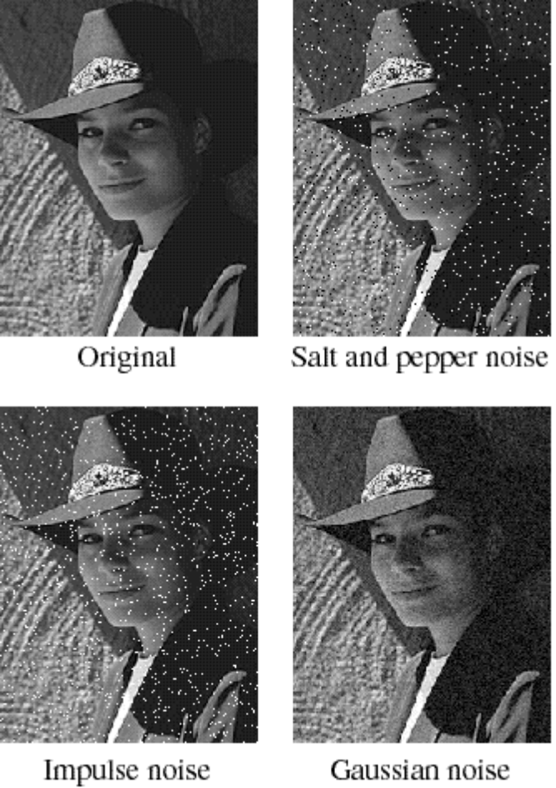
Noise
Image processing is useful for noise reduction...
Common types of noise:
  Salt and pepper noise: contains random occurrences of black and white pixels
  Impulse noise: contains random occurrences of white pixels
  Gaussian noise: variations in intensity drawn from a Gaussian normal distribution
Notes:
Salt and pepper and impulse noise can be due to transmission errors (e.g., from deep space probe), dead CCD pixels, specks on lens
We’re going to focus on Gaussian noise first.
If you had a sensor that was a little noisy and measuring the same thing over and over, how would you reduce the noise?

Slide 8
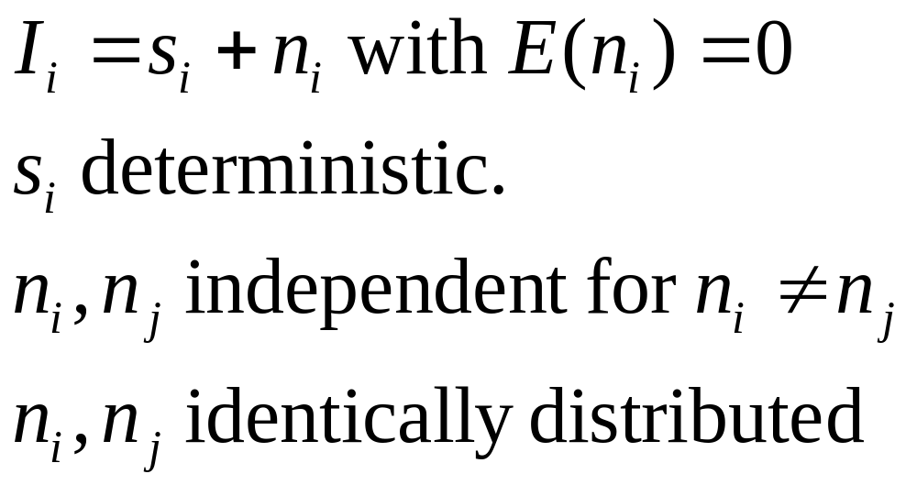
Additive noise
We often assume the noise is additive
I = S + N. Noise doesn’t depend on signal.
We’ll consider:

Slide 9
Practical noise reduction
How can we “smooth” away noise in a single image?
0 | 0 | 0 | 0 | 0 | 0 | 0 | 0 | 0 | 0
0 | 0 | 0 | 0 | 0 | 0 | 0 | 0 | 0 | 0
0 | 0 | 0 | 100 | 130 | 110 | 120 | 110 | 0 | 0
0 | 0 | 0 | 110 | 90 | 100 | 90 | 100 | 0 | 0
0 | 0 | 0 | 130 | 100 | 90 | 130 | 110 | 0 | 0
0 | 0 | 0 | 120 | 100 | 130 | 110 | 120 | 0 | 0
0 | 0 | 0 | 90 | 110 | 80 | 120 | 100 | 0 | 0
0 | 0 | 0 | 0 | 0 | 0 | 0 | 0 | 0 | 0
0 | 0 | 0 | 0 | 0 | 0 | 0 | 0 | 0 | 0
0 | 0 | 0 | 0 | 0 | 0 | 0 | 0 | 0 | 0
Notes:
Replace each pixel with the average of a kxk window around it

Slide 10


Mean filtering
0 | 0 | 0 | 0 | 0 | 0 | 0 | 0 | 0 | 0
0 | 0 | 0 | 0 | 0 | 0 | 0 | 0 | 0 | 0
0 | 0 | 0 | 90 | 90 | 90 | 90 | 90 | 0 | 0
0 | 0 | 0 | 90 | 90 | 90 | 90 | 90 | 0 | 0
0 | 0 | 0 | 90 | 90 | 90 | 90 | 90 | 0 | 0
0 | 0 | 0 | 90 | 0 | 90 | 90 | 90 | 0 | 0
0 | 0 | 0 | 90 | 90 | 90 | 90 | 90 | 0 | 0
0 | 0 | 0 | 0 | 0 | 0 | 0 | 0 | 0 | 0
0 | 0 | 90 | 0 | 0 | 0 | 0 | 0 | 0 | 0
0 | 0 | 0 | 0 | 0 | 0 | 0 | 0 | 0 | 0
Notes:
Replace each pixel with the average of a kxk window around it

Slide 11
Notes:
Move around over previous slide

Slide 12
Mean filtering
0 | 0 | 0 | 0 | 0 | 0 | 0 | 0 | 0 | 0
0 | 0 | 0 | 0 | 0 | 0 | 0 | 0 | 0 | 0
0 | 0 | 0 | 90 | 90 | 90 | 90 | 90 | 0 | 0
0 | 0 | 0 | 90 | 90 | 90 | 90 | 90 | 0 | 0
0 | 0 | 0 | 90 | 90 | 90 | 90 | 90 | 0 | 0
0 | 0 | 0 | 90 | 0 | 90 | 90 | 90 | 0 | 0
0 | 0 | 0 | 90 | 90 | 90 | 90 | 90 | 0 | 0
0 | 0 | 0 | 0 | 0 | 0 | 0 | 0 | 0 | 0
0 | 0 | 90 | 0 | 0 | 0 | 0 | 0 | 0 | 0
0 | 0 | 0 | 0 | 0 | 0 | 0 | 0 | 0 | 0
 | 0 | 10 | 20 | 30 | 30 | 30 | 20 | 10
 | 0 | 20 | 40 | 60 | 60 | 60 | 40 | 20
 | 0 | 30 | 60 | 90 | 90 | 90 | 60 | 30
 | 0 | 30 | 50 | 80 | 80 | 90 | 60 | 30
 | 0 | 30 | 50 | 80 | 80 | 90 | 60 | 30
 | 0 | 20 | 30 | 50 | 50 | 60 | 40 | 20
 | 10 | 20 | 30 | 30 | 30 | 30 | 20 | 10
 | 10 | 10 | 10 | 0 | 0 | 0 | 0 | 0
Notes:
Replace each pixel with the average of a kxk window around it
What happens if we use a larger filter window?

Slide 13
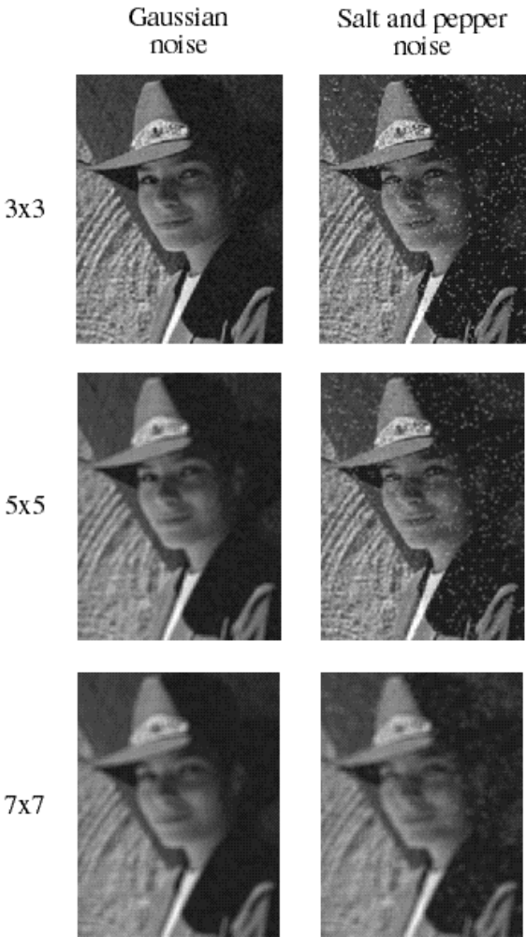
Effect of mean filters
Notes:
Demo with photoshop

Slide 14
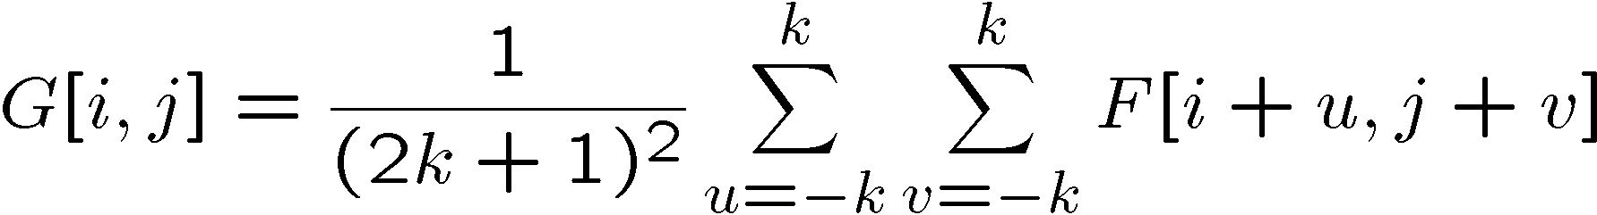
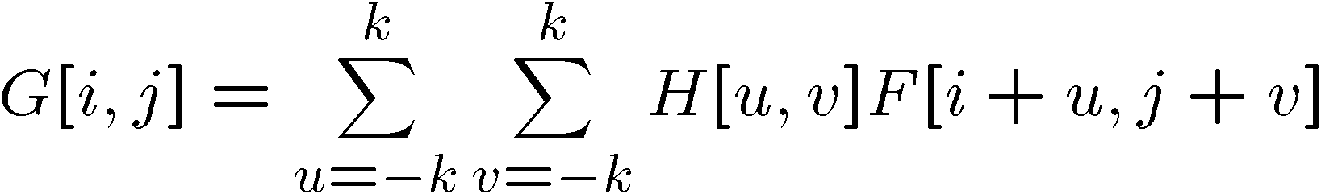

Cross-correlation filtering
Let’s write this down as an equation. Assume the averaging window is (2k+1)x(2k+1):
We can generalize this idea by allowing different weights for different neighboring pixels:
This is called a cross-correlation operation and written:
H is called the “filter,” “kernel,” or “mask.”
The above allows negative filter indices. When you implement need to use: H[u+k,v+k] instead of H[u,v]

Slide 15

Mean kernel
What’s the kernel for a 3x3 mean filter?
0 | 0 | 0 | 0 | 0 | 0 | 0 | 0 | 0 | 0
0 | 0 | 0 | 0 | 0 | 0 | 0 | 0 | 0 | 0
0 | 0 | 0 | 90 | 90 | 90 | 90 | 90 | 0 | 0
0 | 0 | 0 | 90 | 90 | 90 | 90 | 90 | 0 | 0
0 | 0 | 0 | 90 | 90 | 90 | 90 | 90 | 0 | 0
0 | 0 | 0 | 90 | 0 | 90 | 90 | 90 | 0 | 0
0 | 0 | 0 | 90 | 90 | 90 | 90 | 90 | 0 | 0
0 | 0 | 0 | 0 | 0 | 0 | 0 | 0 | 0 | 0
0 | 0 | 90 | 0 | 0 | 0 | 0 | 0 | 0 | 0
0 | 0 | 0 | 0 | 0 | 0 | 0 | 0 | 0 | 0
Notes:
ones, divide by 9

Slide 16
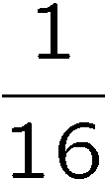
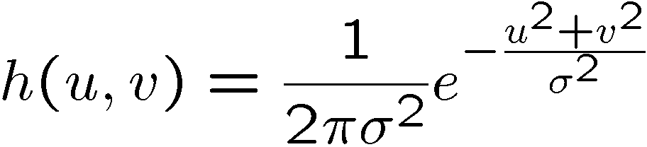
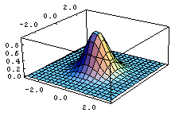
Gaussian Filtering
A Gaussian kernel gives less weight to pixels further from the center of the window
This kernel is an approximation of a Gaussian function:
0 | 0 | 0 | 0 | 0 | 0 | 0 | 0 | 0 | 0
0 | 0 | 0 | 0 | 0 | 0 | 0 | 0 | 0 | 0
0 | 0 | 0 | 90 | 90 | 90 | 90 | 90 | 0 | 0
0 | 0 | 0 | 90 | 90 | 90 | 90 | 90 | 0 | 0
0 | 0 | 0 | 90 | 90 | 90 | 90 | 90 | 0 | 0
0 | 0 | 0 | 90 | 0 | 90 | 90 | 90 | 0 | 0
0 | 0 | 0 | 90 | 90 | 90 | 90 | 90 | 0 | 0
0 | 0 | 0 | 0 | 0 | 0 | 0 | 0 | 0 | 0
0 | 0 | 90 | 0 | 0 | 0 | 0 | 0 | 0 | 0
0 | 0 | 0 | 0 | 0 | 0 | 0 | 0 | 0 | 0
1 | 2 | 1
2 | 4 | 2
1 | 2 | 1

Slide 17
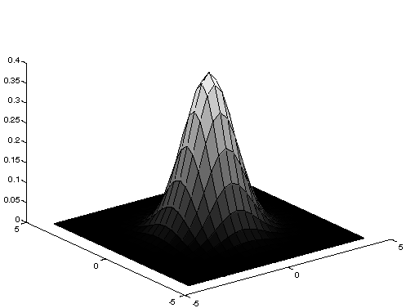
Gaussian Averaging
Rotationally symmetric.
Weights nearby pixels more than distant ones.
  This makes sense as probabalistic inference.
A Gaussian gives a good model of a fuzzy blob

Slide 18
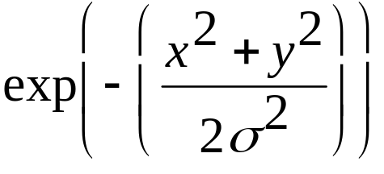
An Isotropic Gaussian
The picture shows a smoothing kernel proportional to
(which is a reasonable model of a circularly symmetric fuzzy blob)

Slide 19
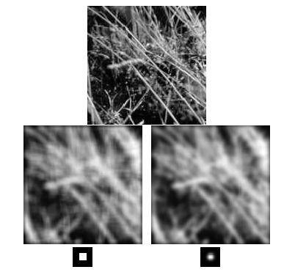
Mean vs. Gaussian filtering

Slide 20
Efficient Implementation
Both, the BOX filter and the Gaussian filter are separable:
  First convolve each row with a 1D filter
  Then convolve each column with a 1D filter.

Slide 21
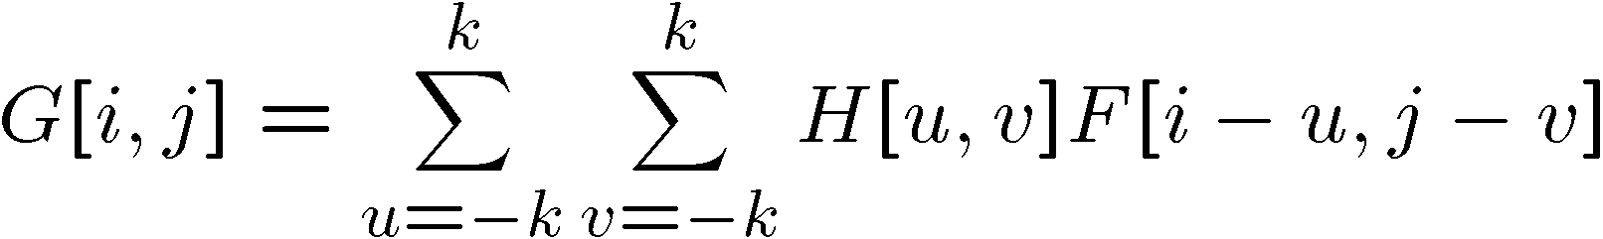

Convolution
A convolution operation is a cross-correlation where the filter is flipped both horizontally and vertically before being applied to the image:
It is written:
Suppose H is a Gaussian or mean kernel. How does convolution differ from cross-correlation?
Notes:
They are the same for filters that have both horizontal and vertical symmetry.

Slide 22
Linear Shift-Invariance
A tranform T{} is
Linear if:
T(a g(x,y)+b h(x,y)) = a T{g(x,y)} + b T(h(x,y))
Shift invariant if:
Given T(i(x,y)) = o(x,y)
T{i(x-x0, y- y0)} = o(x-x0, y-y0)

Slide 23
Median filters
A Median Filter operates over a window by selecting the median intensity in the window.
What advantage does a median filter have over a mean filter?
Is a median filter a kind of convolution?
Median filter is non linear
Notes:
Better at salt’n’pepper noise
Not convolution: try a region with 1’s and a 2, and then 1’s and a 3

Slide 24
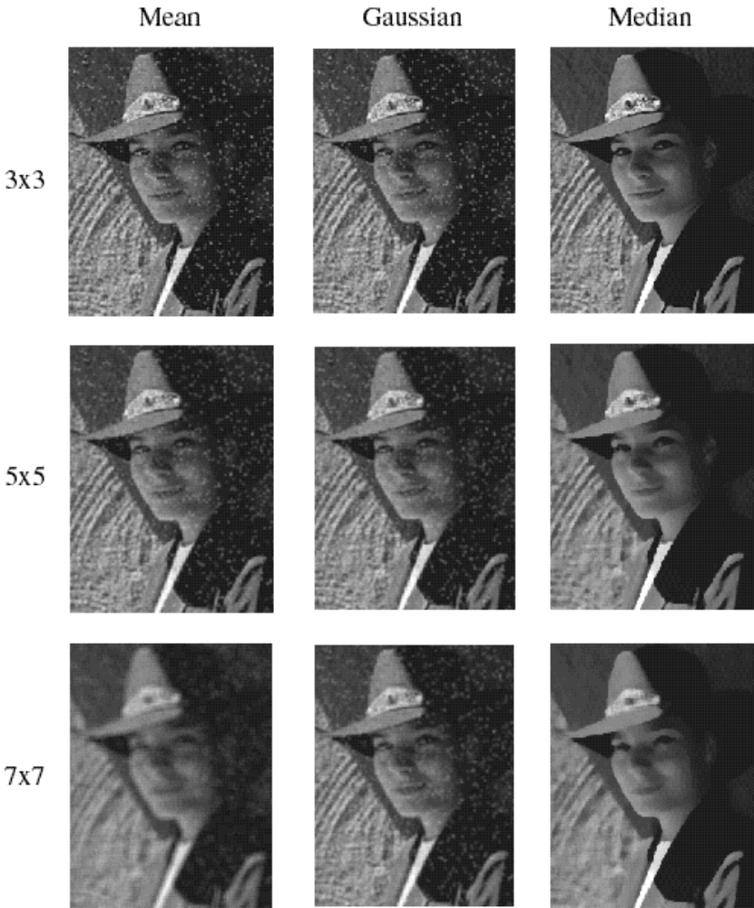
Comparison: salt and pepper noise

Slide 25
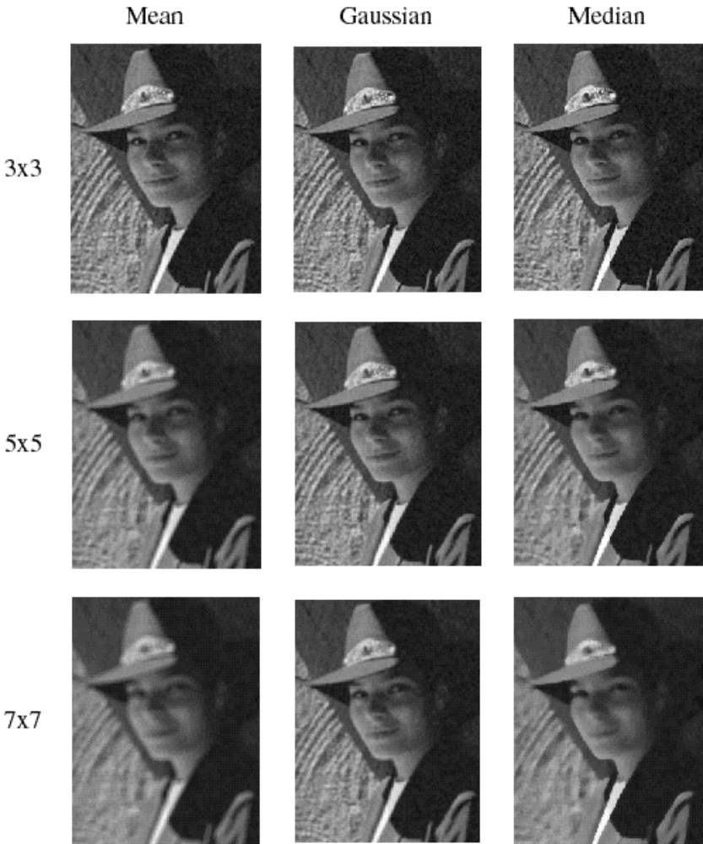
Comparison: Gaussian noise

